Slide 1
2023-2024 FAFSA Filing
Office of Student Financial Services
206 Memorial Hall
SFS@hofstra.edu

Slide 2
Topics
Financial Aid Programs
How and When to Apply
Filing the FAFSA
Helpful FAQs, Tips, & Resources
Questions and Answers

Slide 3
What is Financial Aid?
Financial Aid
Federal Work-Study
Grants & Scholarships (Gift Aid)
Loans

Slide 4
Federal Work Study (FWS)
Eligibility determined through the FAFSA
Most jobs worked on campus & hours are based on student schedule
Students earn wages
Funds are not applied to a student’s billing account
Part-time jobs or UG Assistantships
Earn more than just a degree!
Valuable networking opportunities

Slide 5
Gift Aid
Scholarships
Institutional/Outside
Grants
Institutional
Federal Pell
Federal Supplemental Opportunity Grant (SEOG)
N.Y.S. Tuition Assistance Program (TAP)

Slide 6
Scholarship Search Sites
Finaid.org
Scholarships.com
Fastweb.com
*Note: Links are provided as a general information resource. The links provided are maintained by their respective organizations and they are solely responsible for their content. Hofstra does not favor one link over the other, nor does Hofstra endorse or profit, in whole or in part, from any products or services offered or promoted by any of the websites whose links appear.

Slide 7
Loans
Federal Education Loans 2022-2023 rates
Stafford Loans Subsidized and Unsubsidized (4.99% interest rate, 1.059% orig. fee)
Parent Plus Loan (7.54% interest rate, 4.228% orig. fee)
Alternative/Personal Student Loans (variable rates and terms)
Home Equity Loan
Note: 2023-2024 rates will be available July 1st 2023
Notes:
Subsidized and Unsubsidized Stafford Loans
Annual limit for freshman =$5,500 gross
* 3.76% interest rate, 1.069% loan fee
Federal Parent Plus Loan
Annual limit = Student’s Cost of Attendance
* 6.31% interest rate, 4.276% loan fee

Slide 8
Financial Aid Timeline 2023-2024
September - December of Senior Year in HS
Student and one parent apply for FSA ID
studentaid.gov/FSAID
File Free Application for Federal Student Aid (FAFSA) Available as of October 1 www.studentaid.gov
NYS Residents- File Tuition Assistance Program (TAP) application Available as of October 1 www.HESC.ny.gov
College Scholarship Service (CSS) Profile Application
Available October 1, not required by Hofstra
Apply for outside scholarships
Notes:
Parents may use the same FSA for all children in college
Link at the end of the FAFSA for TAP- can submit 3-5 days after filing the FAFSA if you miss the link

Slide 9
Financial Aid Timeline
January- March
Please file your FAFSA by February 1
Colleges/universities begin to send out financial aid award packages (FAFSA filing deadlines and timing of award notifications will vary between schools)
Complete verification (if required) and other requested forms
(proof of citizenship, selective service)
April-May
Pay tuition/housing deposits and accept/decline financial aid by the National Candidate Reply Date of May 1
Complete loan applications and requirements after May 1

Slide 10
Who is eligible for Federal Aid?
U.S. citizens and eligible non-citizens, such as permanent residents, are eligible to file the FAFSA and receive Federal Aid
Males between the ages of 18 and 25 must register with Selective Service www.sss.gov
Students must have a valid Social Security Number
If a parent does not have a SSN, enter zeroes on the FAFSA
Deferred Action (DACA) students are not eligible to file a FAFSA and are not eligible for federal financial aid.

Slide 11
Why file the FAFSA?
It’s free!
It determines eligibility for federal grants, loans and work study
Some states, including New York, require it as the first part of an application process for financial aid from that state
Some colleges and private organizations require it for consideration of scholarships and grants

Slide 12
What will you need to file the FAFSA?
Collect the documents needed for both the student and parent(s):
All sources of 2021 taxed and untaxed income such as income tax returns, W2 forms, benefit statements, etc. Use the IRS Data Retrieval to simplify the process!
Asset information such as your most recent bank statements, investments, stocks, bonds, mutual funds, etc.
Social Security numbers
Student driver’s license (if applicable)
Alien registration number (if applicable)

Slide 13
FAFSA FAQs
Q. Can a student choose to report 2022 information?
A. No; you must report info for the year the FAFSA asks for
Remember: Certain items on FAFSA are “as of today,” so you must read each question and fill out accordingly
If questions are answered incorrectly, your FAFSA could be selected for Verification
Q. What if my family’s financial situation changed since 2021?
A. Speak with the colleges you are accepted to and add on your FAFSA Each school may handle these situations differently Most colleges have a special form/process for this

Slide 14
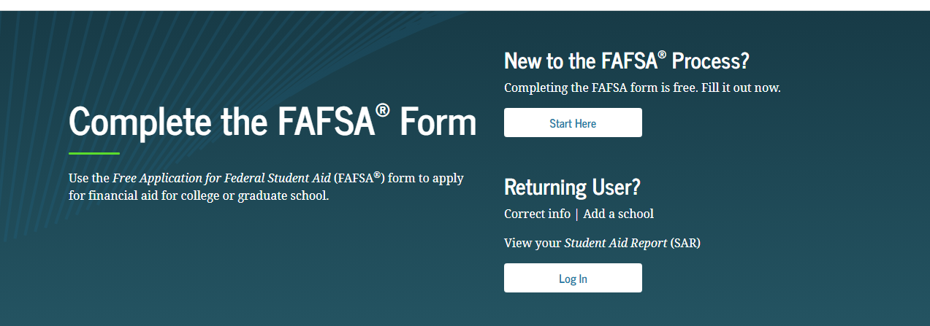
Home Page https://studentaid.gov

Slide 15
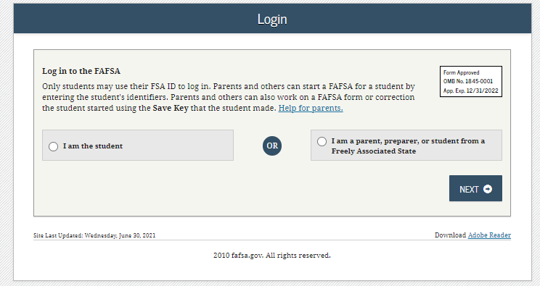
Login
Notes:
Entering the FSA ID will allow the student to sign the FAFSA at the end without entering this information again

Slide 16
Student Demographics
Student information:
Name
Date of Birth
SSN
Etc.
Please remember this is the student’s application so please pay attention to the information it is asking for.

Slide 17
Listing Schools
Add any school that you are considering even if you have not yet applied or have been accepted.
You do not need to apply to all schools you add to your FAFSA

Slide 18
FAFSA FAQ
Q. I can only send the FAFSA to 10 colleges online, what if I need to send the FAFSA to more?
A. You can change the codes by going back into the FAFSA online or call 1-800-4-FED-AID and do it over the phone. By doing this, you are actually removing some of the previous schools listed and therefore future changes to the FAFSA will only be sent to the 10 schools most recently listed on the FAFSA.

Slide 19
Answer Dependency Status Questions
This is a series of specific questions that will determine if you are required to provide parent information.
Dependency guidelines are set by federal regulations , and if you are determined as independent you need to provide specific information
Please note, if a student is under 24 years of age they are considered dependent.

Slide 20
Parent Section
A legal parent includes a biological or adoptive parent, or a person that the state has determined to be your parent (for example, when a state allows another person’s name to be listed as a parent on a birth certificate). Grandparents, foster parents, legal guardians, older brothers or sisters, widowed stepparents, and aunts and uncles are not considered parents unless they have legally adopted you.

Slide 21
FAFSA FAQs
Q. My parents are separated or divorced and living apart, whose information do I put on the FAFSA?
A. You should report the information for the parent who you lived with the most over the past 12 months, regardless of who claims you on their income tax return.
Q. Do parents have to be legally separated to file the FAFSA as separated?
No. Colleges may ask for proof of separate residences such as a copy of a lease and utility bills.
Q. My step-parent is not responsible for supporting me, why do I have to report his/her information on the FAFSA?
A. If the parent you reside with is re-married, federal regulations require you to report your step-parent’s information on the FAFSA.
Notes:
If you did not live with one parent more than the other, report the information for the parent who provided the most financial support. If parents are separated/divorced but still living in the same household, report information for both parents.

Slide 22
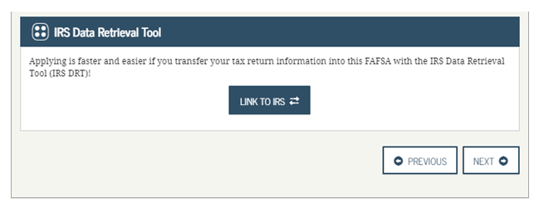
IRS Data Retrieval

Slide 23
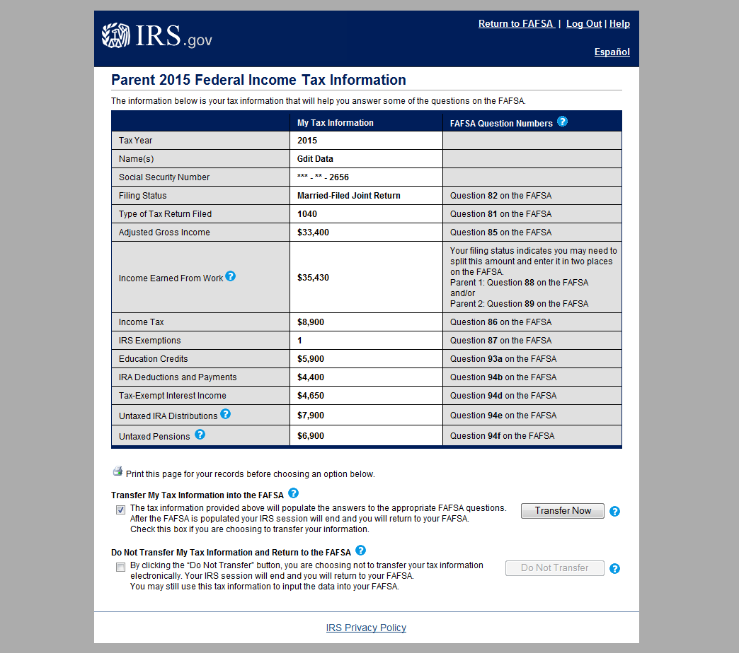
IRS Data Retrieval

Slide 24
Assets
Asset net worth means current value of the assets minus what is owed
Assets include:
Money in cash, savings, and checking accounts
Businesses
Investment farms
Other investments, such as real estate (other than the home in which you live), UGMA and UTMA accounts for which you are the owner, stocks, bonds, certificates of deposit, etc.
Assets do not include:
The home in which you live
UGMA and UTMA accounts for which you are the custodian, but not the owner
The value of life insurance
Retirement plans (401[k] plans, pension funds, annuities, non-education IRAs, Keogh plans, etc.)

Slide 25
FAFSA FAQ
Q. How are 529 plans reported on the FAFSA?
A. 529 plans are reported under the “owner” as an investment, not the beneficiary. If the parent is the owner, it is reported under the parent investment question. If the parent has more than one 529 plan for various members of the family including siblings of the student, the total value of all plans must be reported under the parent.

Slide 26
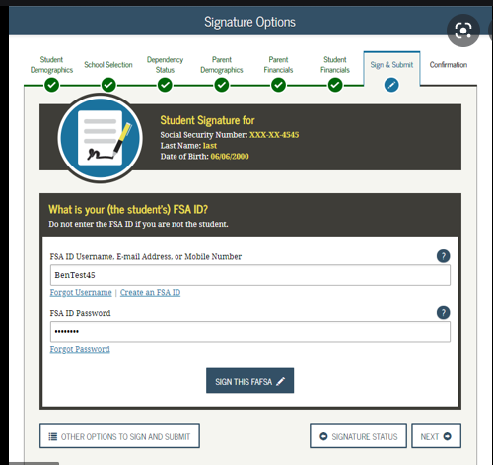
Student Signature Page

Slide 27
Parent Signature Page

Slide 28
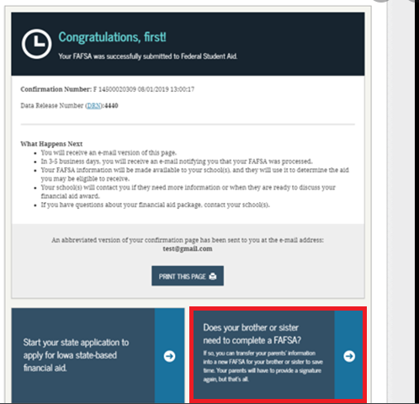
Confirmation Page
Notes:
Link to sibling FAFSA
Will also have link to TAP

Slide 29
What Happens Next?
After your FAFSA is processed, you will receive a Student Aid Report (SAR) with estimated eligibility. This report will also include your EFC (Expected Family Contribution) or Student Aid Index.
Each school listed on your FAFSA will receive the information you submitted. If accepted for admission, the college (s) will calculate/prepare a financial aid package.
Further details regarding your awards and other required documents will be provided within the aid package.
Accept or decline the aid offered to you and return the response to the aid office as early as possible, but no later than May 1.

Slide 30
Verification?
Your SAR (Student Aid Report) will notify you if you have been selected by the FAFSA processor and the college (s) you apply to will also be notified.
Submit signed 2021 income documentation
Request copies of 2021 federal “Tax Return Transcripts” in advance IRS.gov/transcript
Don’t miss out!
Additional aid may be offered upon completion of verification
Aid may be adjusted based on corrections

Slide 31
Should I hire a consultant to help me file the FAFSA?
FAFSA Tip
We do not recommend paying a fee when you can get the help you need, right from the source, for free.
Specialized FAFSA representatives are available to assist you step-by-step through the application at 1-800-4-FEDAID (1-800-433-3243) or by clicking the “Live Help” button to chat with a FAFSA representative.

Slide 32
FAFSA Tips
What are some common mistakes students and families make when completing the FAFSA?
Not asking for help, call 1-800-4-FEDAID, utilize the FAFSA online chat, or use the self-service buttons throughout the FAFSA
File the correct FAFSA for the correct aid year
Do not use nicknames- use the name as spelled on the SS card
Use correct Social Security numbers and date of births
Do not list parent income/information under the student section
Make sure both student and parent signatures go through
If your address has changed, update your admission application

Slide 33
Helpful Links for Financial Aid Resources:
Hofstra Aid: hofstra.edu/sfs
Federal: https://studentaid.ed.gov/sa/
NY State: www.hesc.ny.gov
General: www.finaid.org
Note: Links are provided as a general information resource for the use of visitors to the web site. The links provided are maintained by their respective organizations and they are solely responsible for their content. Hofstra does not favor one link over the other, nor does Hofstra endorse or profit, in whole or in part, from any products or services offered or promoted by any of the web sites whose links appear.

Slide 34
Questions?

